Slide 1
Model Governance and Validation
ACHS Fall 2023
Sarah Chen, MAAA, FSA, CFA
Linda Lankowski, MAAA, FSA
November 2, 2023

Slide 2
Agenda
Model Governance
Model Risk Management Framework
Model Governance Policies
Model Validation
Model Validation Journey
Model Validation - Modernization
Model Validation – Myths

Slide 3
Model Risk Management Framework
Model Definition
Model Inventory
Risk Measurement
Risk Appetite
Metrics
Written Policies and Standards
Oversight

Slide 4
Definition of a Model
From ASOP 56
A simplified representation of relationships among real world variables, entities, or events using statistical, financial, economic, mathematical, non-quantitative, or scientific concepts and equations. A model consists of three components:
an information input component, which delivers data and assumptions to the model;
a processing component, which transforms input into output; and
a results component, which translates the output into useful business information.

Slide 5
Model Inventory
Choose a level of granularity
Model is made up of components – input, processing, output
Examples of granularity levels
Valuation Model, Pricing Model, Assumptions Model, Capital Model
Separate Valuation Models for Stat & GAAP
Separate Valuation Models for VA, FA, Life, DI, Group Life, Group Annuities
End-User Computing software may be component
Spreadsheets for consolidating results, testing new models
Alteryx, Tableau, Power BI, etc. for input or output

Slide 6
Risk Measurement
“Risk of adverse consequences resulting from reliance on a model that does not adequately represent that which is being modeled or that is misused or misinterpreted”
Consider
Who relies on the results?
How material is the result?
Complexity of model and calculations
Think of this as a grid with multiple dimensions

Slide 7
Risk Appetite & Metrics
Risk/Reward tradeoff
Measure of Importance
Measure of Accuracy

Slide 8
Model Documentation
Examples from Model Governance and Model Risk Management Practice Notes
A description of the model and its intended purpose, including modeling platform, inputs, and outputs;
Process maps identifying key controls and data handoff points;
Process(es) used to update model data;
Assumptions and methodologies;
Limitations and risks not modeled;
Approximations and shortcuts;
Applicable vendor or third-party documentation and rationale for the selection of options where options exist; and
Data output and reports
Model owner as of a date
Intended purpose and uses
Version/last change date
Summary of last validation and result
Assumptions made in model construction
Developer notes associated with any codes or calculation engine underlying the model
Data sources and formats
Parameter assumptions
Dependencies on other models and processes
Key outputs
Applicable regulations and guidelines
Limitations and future research areas
Detailed step-by-step user instructions

Slide 9
Oversight
Not a single person
Roles & Responsibilities
Separation of Duties
3 Lines of Defense

Slide 10
Documentation of Controls
MRM Policies
Change Control
User Access
Validation Controls
Process document
Software requirements
Notes:
Change Control documentation includes the model change request, documentation of the improvement and how it was validated
Process document includes limits and thresholds – for verification and additional review

Slide 11
Resources
Modeling - ASOP 56
Model Risk Management Practice Note
Model Governance Practice Note
Model Governance Checklist
SR 11-7: Supervisory Guidance on Model Risk Management

Slide 12
Model Validation

Slide 13
Definition of Models
A model is defined on SR11-7 (Supervisory Guidance on Model Risk Management) issued by the United States Board of Governors of the Federal Reserve System as:
“A quantitative method, system, or approach that applies statistical, economic, financial, or mathematical theories, techniques, and assumptions to process input data into quantitative estimates”.
Each model consists of three model components:
An information input component, which includes inforce data, scenarios, assumptions, and product features data.
A processing component, which contains calculations using inputs and
A reporting/output component, which generates desired business information.
Input
Processing
Output
Notes:
The last piece of the sentence is the essence of the definition. This leads to the three components of a model.

Slide 14
Model Validation
When do we need model validation?
How do we perform model validation?
Why do we need to perform model validation?
What model components do we need to validate? To what extend and how often?
Who should be performing model validation?

Slide 15
Model Validation Journey
Model Validation Journey
Phase 1
Phase 2
Phase 3
Phase 4
Identify driver(s)
(When/Why)
Establish validation scope (What)
Execute validation
(How)
Monitor process and results (Now what)
“Why do we need model validation for this specific model? Under what situation?”
“What model component(s) do we need to validate? To what extend and how often?”
“How do we perform model validation? Who should be performing model validation?”
“Now that the model is up and running in production, what else do we need to do on an ongoing basis?
Notes:
- Circulative process

Slide 16
Phase 1: Identify Drivers of Model Validation (When/Why)
I. | New Modeling Platform | Model conversion Artificial Intelligence and Machine Learning (AI/ML) modeling platform
2. | New Model Use Case(s) | A new use case was created for risk management purposes, e.g., ALM, Liquidity risk management, COVID risk management. A new captive was established, e.g. a Bermuda domiciled captive. Other new use cases
3. | New Product(s) | New version of the existing products Brand new products
4. | New Regulation | Change in statutory valuation standard (PBR) Change in accounting standards (US GAAP LDTI, IFRS 17, Bermuda Regulations etc.)
5. | Ongoing Updates | Production model updates: Input updates, including inforce updates, assumption updates, and scenario updates etc. Model change requests: Input setup Calculation methodology updates Output updates, including reporting, disclosures and analysis

Slide 17
Phase 2: Establish Validation Scope (What)
The scope of model validation is often differentiated by three lines of defense.
1st Line of Defense (Business Teams)
Model Development Validation
Depending on situations, either holistic or specific model validation will be performed by the model developers.
Holistic independent model validation
Input
Processing
Output (reporting, disclosures and analysis)
Specific model component validation
User Acceptance Testing (UAT)
Before the model goes into production, UAT is often performed by the model users.
Focus more on the output
Compare the output with the previous model or similar use cases
Ongoing Monitoring
2nd Line of Defense (Model Risk Management Team)
Holistic independent model validation (e.g., new modeling platform, etc.)
Controls and procedures review
3rd Line of Defense (Internal Audit)
Holistic independent model validation (e.g., if a holistic model validation was not performed by the 2nd line of defense)
MRM policy review, and documentation review from the first two lines of defense

Slide 18
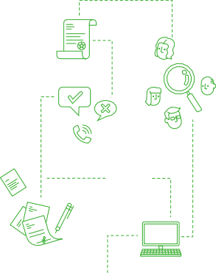
Phase 2: Establish Validation Scope (What) (cont.)
Every model change is subject to model validation to a certain degree.
The scope and frequency of model validation depends on the risk rating of the model and the degree of model changes.
Significant model changes: sufficient model validation is needed. Whether a holistic model validation or specific model validation depends on the model risk rating and the degree of model changes.
Non-significant model changes: only peer review (considered as one type of model validation) is needed.
Examples of significant model changes include, but are not limited to:
Approved new use case of the model
Nature or source of model inputs
Calculation methodology
Modeling platform (e.g., from spreadsheet to cloud system)
Ongoing monitoring approach and/or thresholds
Examples of non-significant model changes include, but are not limited to:
Changes to optimize performance
Rewriting of code to improve readability
Bug fixes with no numerical impact

Slide 19
Phase 2: Establish Validation Scope (What) (cont.)
1. | New Modeling Platform
2. | New Model Use Case(s)
3. | New Product(s)
4. | New Regulation
Holistic Independent Model Validation
Input
Processing
Output (reporting, disclosures and analysis)
5. | Ongoing Updates
Specific model component validation

Slide 20
Phase 3: Execute Validation (How)
 | Validation Approach | Item | Source of Truth | Sampling Approach
I. Input | Compare the model inputs with the source of truth | Inforce data (incl. reinsurance) | Admin systems; treaties | No sampling
 |  | Assets (if it’s externally projected assets) | Assets projection system | No sampling
 |  | Product features | Product specifications | Often yes
 |  | Assumptions | Approved assumption memos | Often yes
 |  | Scenarios | Approved scenarios document | No sampling
 |  | Sensitivities (incl. assumptions and/or scenarios) | Approved sensitivities document | No sampling
II. Processing | Recalculate the values outside of model, or review the calculation formulas within the model | Recalculate cash flow projections by using an Excel replication tool for closed systems (e.g. Moody’s AXIS) and/or formula review for open systems (e.g. Prophet) | Regulations | Yes
 |  | Recalculate reserves by using an Excel replication tool for closed systems and/or formula review for open systems. | Regulations | Yes
III. Output | Reproduce the output, review and evaluate the disclosures and/or analysis | Reporting and Disclosures | Regulations and business needs | No sampling
 |  | Analysis | Regulations and judgement | No sampling
 |  | Model run controls (e.g. cloud processing) | IT controls or operational controls | No sampling
Holistic Independent Model Validation

Slide 21
Phase 3: Execute Validation (How) (cont.)
 | I. Part of the 3 model components are tested. | Input Processing Output
 | II. Ongoing Updates: | Input changes: Compare the model inputs with the source of truth Single cell testing or group testing to compare model results between pre- and post updates Processing - model corrections: Recalculate the values in excel Single cell testing to compare model results between pre- and post updates Output revisions: Reproduce the output and review the revisions
Specific Model Component Validation

Slide 22
Phase 3: Execute Validation (How) (cont.)
Model Validation Findings
Finding categories
II. Impact analysis
Input revisions
Model revisions
Modeling methodology improvements
Documentation improvements
Process improvements
Excel Replication Tool (ERT) improvements
Input and model related findings
Need to rerun the model with updates to quantify each of the finding impact
Documentation improvements
In general, it would be low impact.
Process improvements and Excel Replication Tool (ERT) improvements
In general, it would be low to moderate impact depending on situations.

Slide 23
Phase 4: Monitor Process and Results (Now What)
“Now that the model is up and running in production, what else do we need to do on an ongoing basis?
Ongoing monitoring confirms that the model is properly implemented, used and performing as intended.
The MRM Group is responsible for reviewing the significance of model changes and determining the rigor of revalidation.
Models are subject to revalidation:
As result of a triggering event (e.g., significant changes to the model use or the model, significant findings etc.)
At the request of the MRM
Per the minimum revalidation frequency
The minimum revalidation frequency is often commensurate with the model’s risk level. An example is shown in the table below.
Model risk level | Minimum revalidation frequency
Tier 1 | Every 1 year
Tier 2 | Every 3 years
Tier 3 | Every 5 years

Slide 24
Artificial Intelligence and Machine Learning (AI/ML) Models
Artificial Intelligence and Machine Learning (AI/ML) Models
AI/ML models are models which use AI/ML techniques.
Artificial Intelligence is defined as the application of computational tools to address tasks traditionally requiring human analysis.¹
Machine Learning, a subcategory of artificial intelligence, is defined as a method of designing a sequence of actions to solve a problem that optimizes automatically through experience and with limited or no human intervention.¹
In actuarial, AI/ML models are still evolving. Some companies started using AI/ML models in pricing and accelerated underwriting.
AI/ML models may have periodic calibration or parameter updates.
The processes need to be clearly defined in the model documentation and approved by MRM.
The calibration or parameter updates often do not constitute model changes.
The validation of the calibration or parameter updates is simply to ensure the processes were followed what’s defined in the model documentation.
^{1.} OCC Bulletin 2021-39 issued by the Office of the Comptroller of the Currency
Notes:
Artificial intelligence is the simulation of human intelligence processes by computer systems.
Machine learning is a subset of artificial intelligence that automatically enables a machine or system to learn and improve from experience. Instead of explicit programming, machine learning uses algorithms to analyze large amounts of data, learn from the insights, and then make informed decisions.

Slide 25
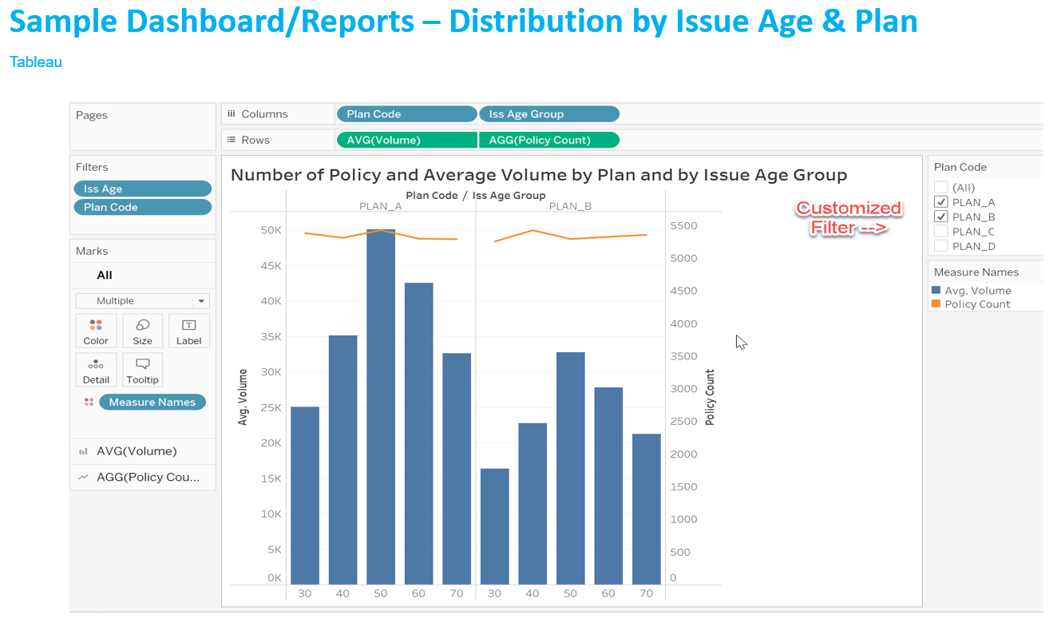
Model Validation – Modernization
Actuarial modernization tools or techniques within the actuarial modeling system offer the chance to reduce work time.
Sampling selection
e.g., Tableau, Power BI
Input validation
Assumptions validation
Product features validation
Processing
e.g., Alteryx
Output analysis
e.g., Tableau, Power BI

Slide 26
Model Validation – Myths
01.
The best modelers are doing model development, and model validation doesn’t need deep modeling skills.
Absolutely wrong
Model validation requires not only outstanding modeling skills, but profound knowledge in the corresponding business and regulations to identify potential inaccurate input and/or faulty modeling setup.
02.
Model validation takes time and requires a big budget, and it’s a good-to-have but not a must-to-have.
Absolutely wrong
The model risk management and regulatory precautions result in real financial benefits and must not be overlooked.

Slide 27
Model Validation – Recap (From 1st Line Perspective)
Development
1
Identify Driver(s)
Validation
2
Establish Scope
3
Execute Validation
Deficiencies Found
No Deficiencies Found
Production
4
Ongoing Monitoring
Revalidation

